Slide 1
Business Intelligence Concepts, Tools, and Applications
Week 1: Decision Making and Decision Support Systems
Lesson 4: Decision Making Support in Practice

Slide 2
Decision Making Support in Practice
Learning objectives
Learn how DSS have evolved over last decade
Comprehend how DSS support various phases of decision making and identify related DSS
Summarize how DSS have evolved into Business Intelligence and Analytic systems

Slide 3
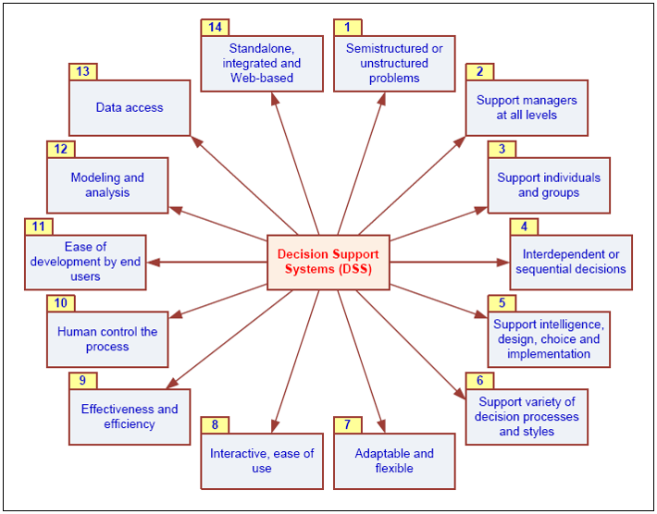
DSS Capabilities
From SHARDA, RAMESH; DELEN, DURSUN; TURBAN, EFRAIM, BUSINESS INTELLIGENCE AND ANALYTICS: SYSTEMS FOR DECISION SUPPORT, 10th Edition, © 2015. Used by permission of Pearson Education, Inc., New York, NY. All Rights Reserved.
Notes:
From SHARDA, RAMESH; DELEN, DURSUN; TURBAN, EFRAIM, BUSINESS INTELLIGENCE AND ANALYTICS: SYSTEMS FOR DECISION SUPPORT, 10th Edition, © 2015. Used by permission of Pearson Education, Inc., New York, NY. All Rights Reserved.

Slide 4
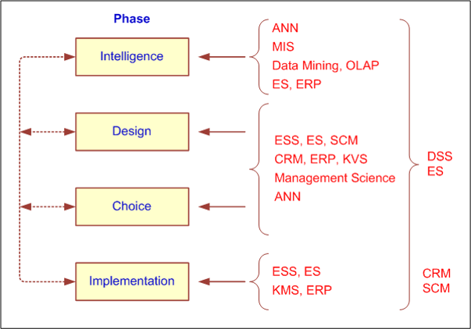
How decisions are supported in Practice
From SHARDA, RAMESH; DELEN, DURSUN; TURBAN, EFRAIM, BUSINESS INTELLIGENCE AND ANALYTICS: SYSTEMS FOR DECISION SUPPORT, 10th Edition, © 2015. Used by permission of Pearson Education, Inc., New York, NY. All Rights Reserved.
Notes:
From SHARDA, RAMESH; DELEN, DURSUN; TURBAN, EFRAIM, BUSINESS INTELLIGENCE AND ANALYTICS: SYSTEMS FOR DECISION SUPPORT, 10th Edition, © 2015. Used by permission of Pearson Education, Inc., New York, NY. All Rights Reserved.

Slide 5
How decisions are supported in practice Intelligence Phase
Enabling continuous scanning of external and internal information sources to identify problems and/or opportunities
Resources/technologies: Web; ES, OLAP, data warehousing, data/text/Web mining, EIS/Dashboards, KMS, GSS, GIS, …
Business activity monitoring (BAM)
Business process management (BPM)
Product life-cycle management (PLM)
Notes:
From SHARDA, RAMESH; DELEN, DURSUN; TURBAN, EFRAIM, BUSINESS INTELLIGENCE AND ANALYTICS: SYSTEMS FOR DECISION SUPPORT, 10th Edition, © 2015. Used by permission of Pearson Education, Inc., New York, NY. All Rights Reserved.

Slide 6
How decisions are supported in practice Design Phase
Generating alternatives
Structured/simple problems
standard and/or special models
Unstructured/complex problems
human experts, ES, KMS, brainstorming/GSS, OLAP, data/text mining
Notes:
From SHARDA, RAMESH; DELEN, DURSUN; TURBAN, EFRAIM, BUSINESS INTELLIGENCE AND ANALYTICS: SYSTEMS FOR DECISION SUPPORT, 10th Edition, © 2015. Used by permission of Pearson Education, Inc., New York, NY. All Rights Reserved.

Slide 7
Support for the Choice Phase
Use sensitivity analyses, what-if analyses, goal seeking
Resources
KMS
CRM, ERP, and SCM
Simulation and other descriptive models
Notes:
From SHARDA, RAMESH; DELEN, DURSUN; TURBAN, EFRAIM, BUSINESS INTELLIGENCE AND ANALYTICS: SYSTEMS FOR DECISION SUPPORT, 10th Edition, © 2015. Used by permission of Pearson Education, Inc., New York, NY. All Rights Reserved.

Slide 8
Support for Implementation Phase
Decision communication, explanation and justification to reduce resistance to change
Resources
Corporate portals, Web 2.0/Wikis
Brainstorming/GSS
KMS, ES
Notes:
From SHARDA, RAMESH; DELEN, DURSUN; TURBAN, EFRAIM, BUSINESS INTELLIGENCE AND ANALYTICS: SYSTEMS FOR DECISION SUPPORT, 10th Edition, © 2015. Used by permission of Pearson Education, Inc., New York, NY. All Rights Reserved.

Slide 9
Other DSS types
Ad hoc DSS
Custom-Made Versus Ready-Made DSS
Institutional DSS
Notes:
From SHARDA, RAMESH; DELEN, DURSUN; TURBAN, EFRAIM, BUSINESS INTELLIGENCE AND ANALYTICS: SYSTEMS FOR DECISION SUPPORT, 10th Edition, © 2015. Used by permission of Pearson Education, Inc., New York, NY. All Rights Reserved.

Slide 10
Generations of DSS
DSS with separate databases
DSS with traditional data warehousing
DSS with real time data warehousing
DSS embedded in other systems
DSS components integrated more frequently
Notes:
From SHARDA, RAMESH; DELEN, DURSUN; TURBAN, EFRAIM, BUSINESS INTELLIGENCE AND ANALYTICS: SYSTEMS FOR DECISION SUPPORT, 10th Edition, © 2015. Used by permission of Pearson Education, Inc., New York, NY. All Rights Reserved.

Slide 11
Evolution of DSS Into Business Intelligence and Analytics
DSS began in the late 1960s with researchers with OR/MS backgrounds
In early 70’s DSS research focused on conceptual foundations, development issues, and applications
In late 70s and early 80s DSS research and practice intertwined
In 80’s additional DSS applications (e.g., EIS, GDSS) emerged
In the early 90’s data warehousing became important
In early 2000 BI tops many CIOs agenda
Today BI and Analytics revolution demands higher-level of skills
Notes:
From SHARDA, RAMESH; DELEN, DURSUN; TURBAN, EFRAIM, BUSINESS INTELLIGENCE AND ANALYTICS: SYSTEMS FOR DECISION SUPPORT, 10th Edition, © 2015. Used by permission of Pearson Education, Inc., New York, NY. All Rights Reserved.

Slide 12

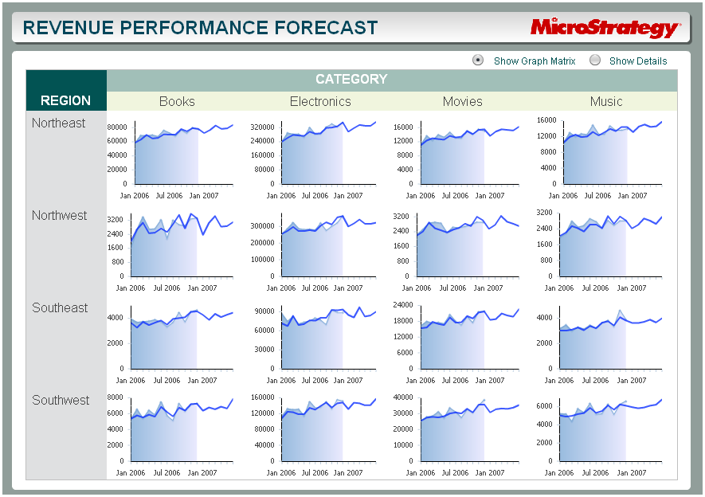
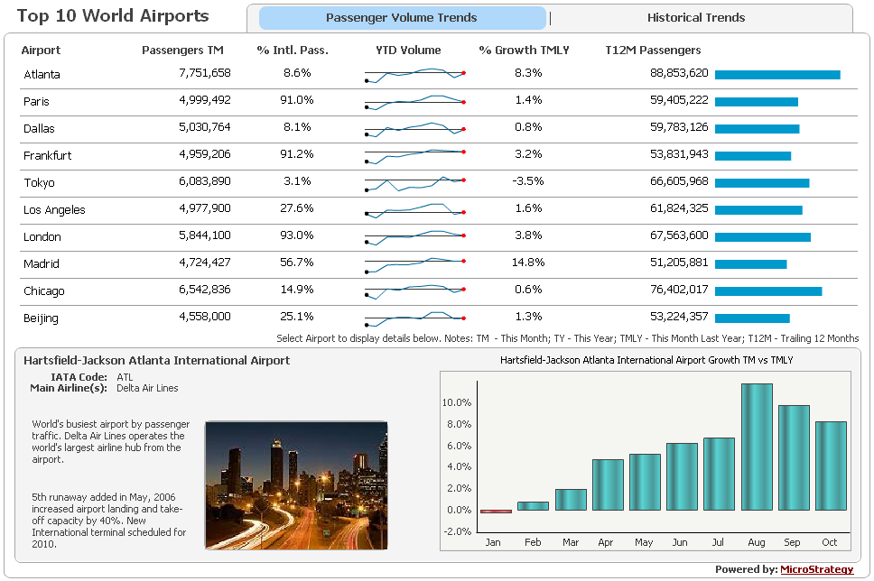
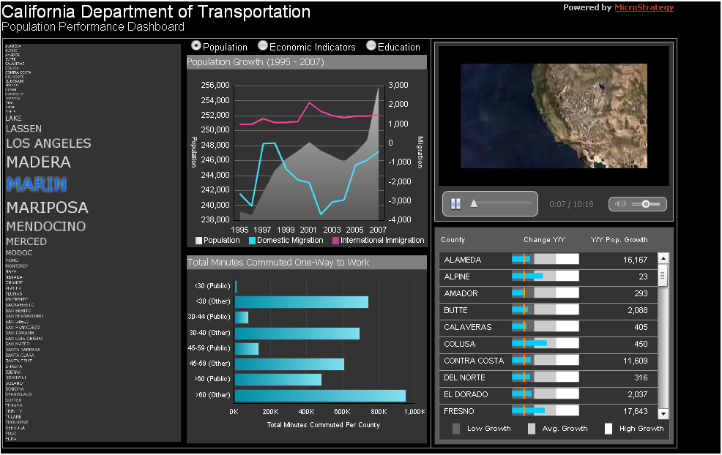
Hands-on Exercise #1 Offline / Standalone Dashboards with Advanced Visualizations
Dynamic Dashboards Help Business People Make Better Decisions, Faster
Notes:
Now, we’re going to have you quickly access some dashboards and experience them yourselves.

